Slide 1
Conformal Transformation

Slide 2
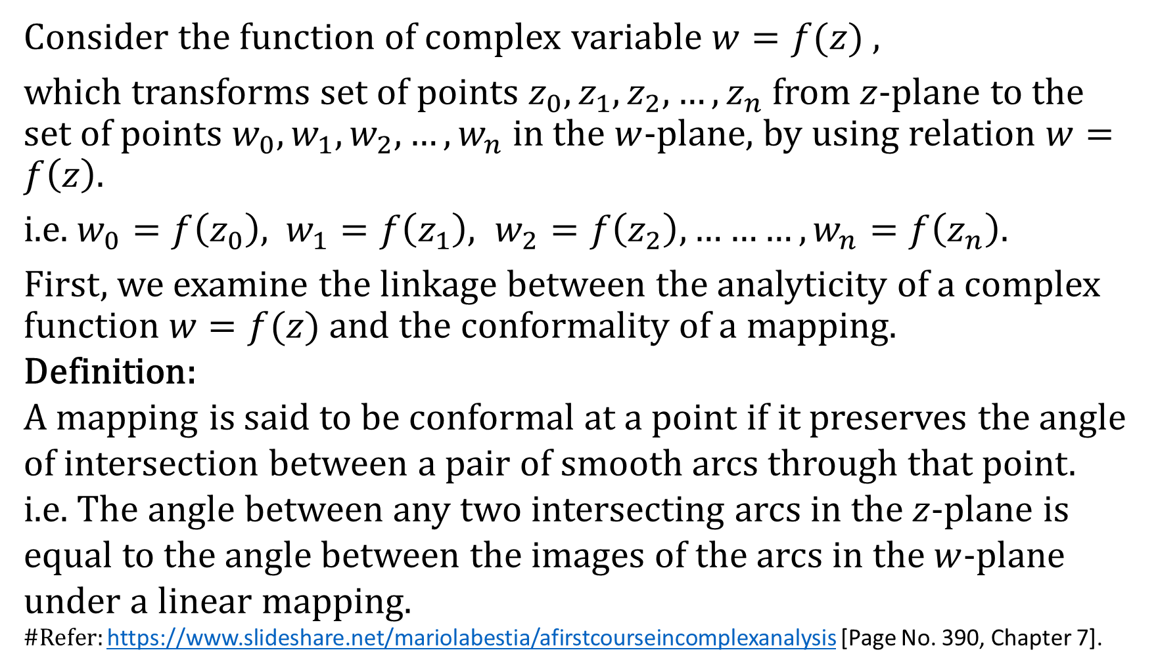
Conformal Transformation:
Consider the function of complex variable $w=f(z)$ ,
which transforms set of points $z_{0}, z_{1}, z_{2}, …, z_{n}$ from $z$-plane to the set of points $w_{0}, w_{1}, w_{2}, …, w_{n}$ in the $w$-plane, by using relation $w=f\left(z\right).$
i.e. $w_{0}=f\left(z_{0}\right),$ $w_{1}=f\left(z_{1}\right), w_{2}=f\left(z_{2}\right),………, w_{n}=f\left(z_{n}\right)$.
First, we examine the linkage between the analyticity of a complex function $w=f(z)$ and the conformality of a mapping.
Definition:
A mapping is said to be conformal at a point if it preserves the angle of intersection between a pair of smooth arcs through that point.
i.e. The angle between any two intersecting arcs in the $z$-plane is equal to the angle between the images of the arcs in the $w$-plane under a linear mapping.
#Refer: https://www.slideshare.net/mariolabestia/afirstcourseincomplexanalysis [Page No. 390, Chapter 7].

Slide 3
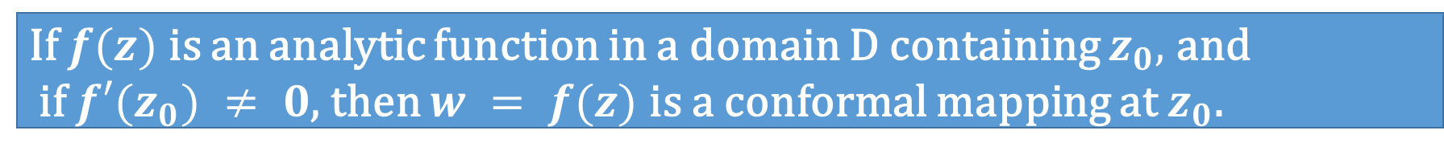
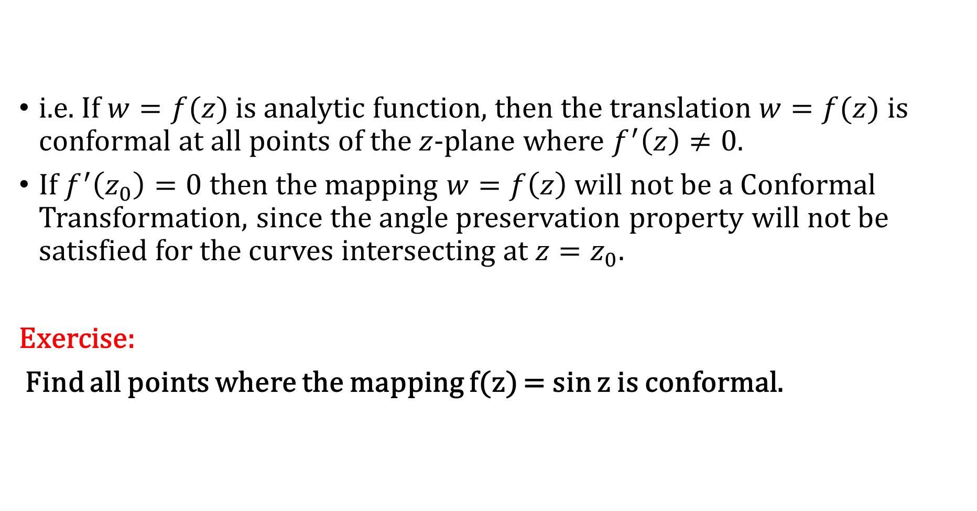
Theorem on Conformal Mapping:
If $f(z)$ is an analytic function in a domain D containing $z_{0},$ and
if $f′(z_{0}) ≠ 0$, then $w = f(z)$is a conformal mapping at $z_{0}$.
i.e. If $w=f(z)$ is analytic function, then the translation $w=f(z)$ is conformal at all points of the $z$-plane where $f^{′}\left(z\right)≠0.$
If $f^{′}\left(z_{0}\right)=0$ then the mapping $w=f\left(z\right)$ will not be a Conformal Transformation, since the angle preservation property will not be satisfied for the curves intersecting at $z=z_{0}$.
Exercise:
Find all points where the mapping f(z) = sin z is conformal.

Slide 4
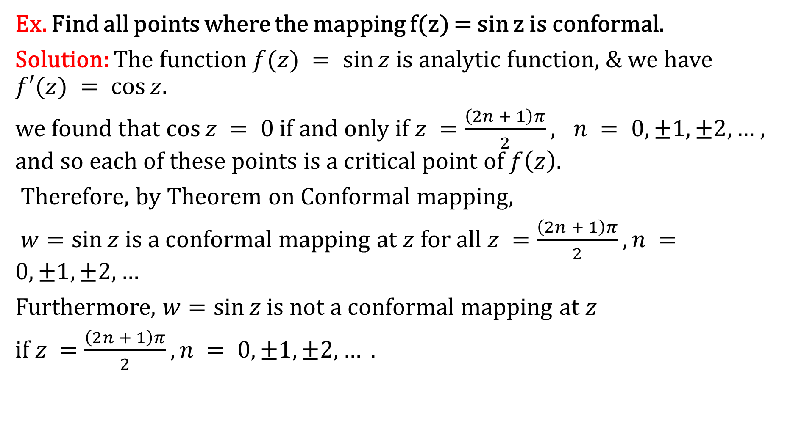
Theorem on Conformal Mapping:
Ex. Find all points where the mapping f(z) = sin z is conformal.
Solution: The function $f(z) = sin⁡z$is analytic function, & we have $f′(z) = cos⁡z$.
we found that $cos⁡z = 0$if and only if $z =\frac{\left(2n + 1\right)π}{2}, n = 0, ±1, ±2, …$, and so each of these points is a critical point of $f\left(z\right)$.
Therefore, by Theorem on Conformal mapping,
$w=sin⁡z$ is a conformal mapping at $z$ for all $z =\frac{\left(2n + 1\right)π}{2}, n =0, ±1, ±2, …$
Furthermore, $w=sin⁡z$ is not a conformal mapping at $z$
if $z =\frac{\left(2n + 1\right)π}{2}, n = 0, ±1,±2, … .$

Slide 5
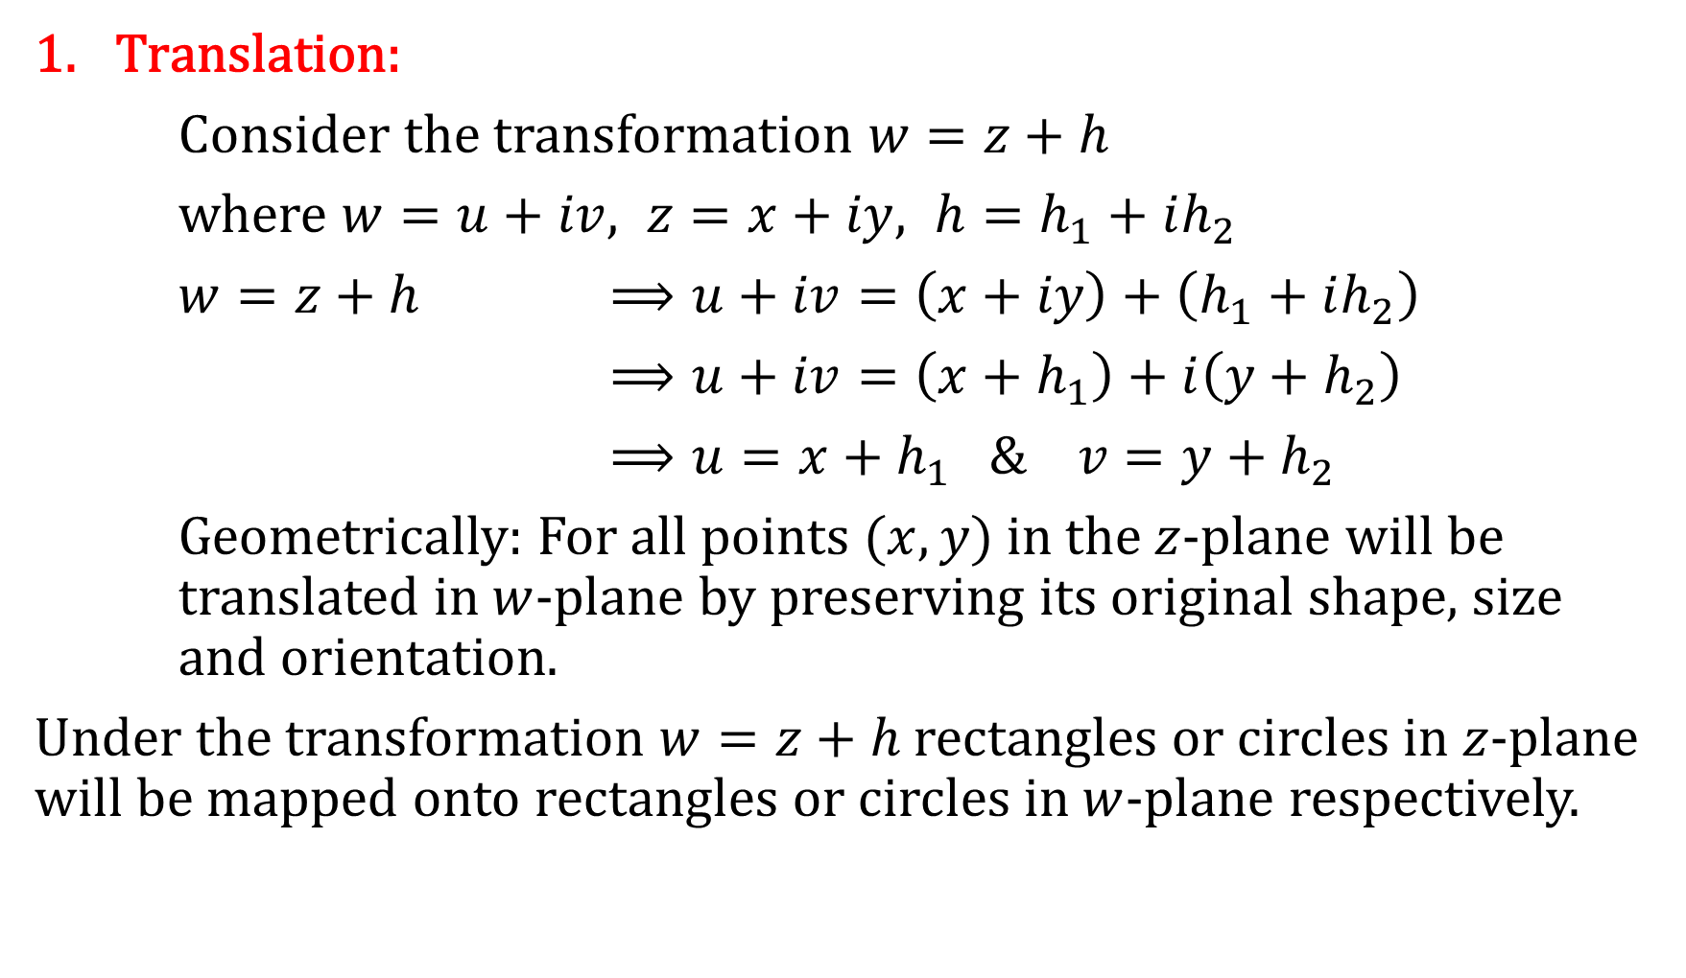
Some Important Transformations:
Translation:
Consider the transformation $w=z+h$
where $w=u+iv, z=x+iy, h=h_{1}+ih_{2}$
$w=z+h$ $⟹u+iv=\left(x+iy\right)+\left(h_{1}+ih_{2}\right)$
$⟹u+iv=\left(x+h_{1}\right)+i\left(y+h_{2}\right)$
$⟹u=x+h_{1} \& v=y+h_{2}$
Geometrically: For all points $(x,y)$ in the $z$-plane will be translated in $w$-plane by preserving its original shape, size and orientation.
Under the transformation $w=z+h$ rectangles or circles in $z$-plane will be mapped onto rectangles or circles in $w$-plane respectively.

Slide 6
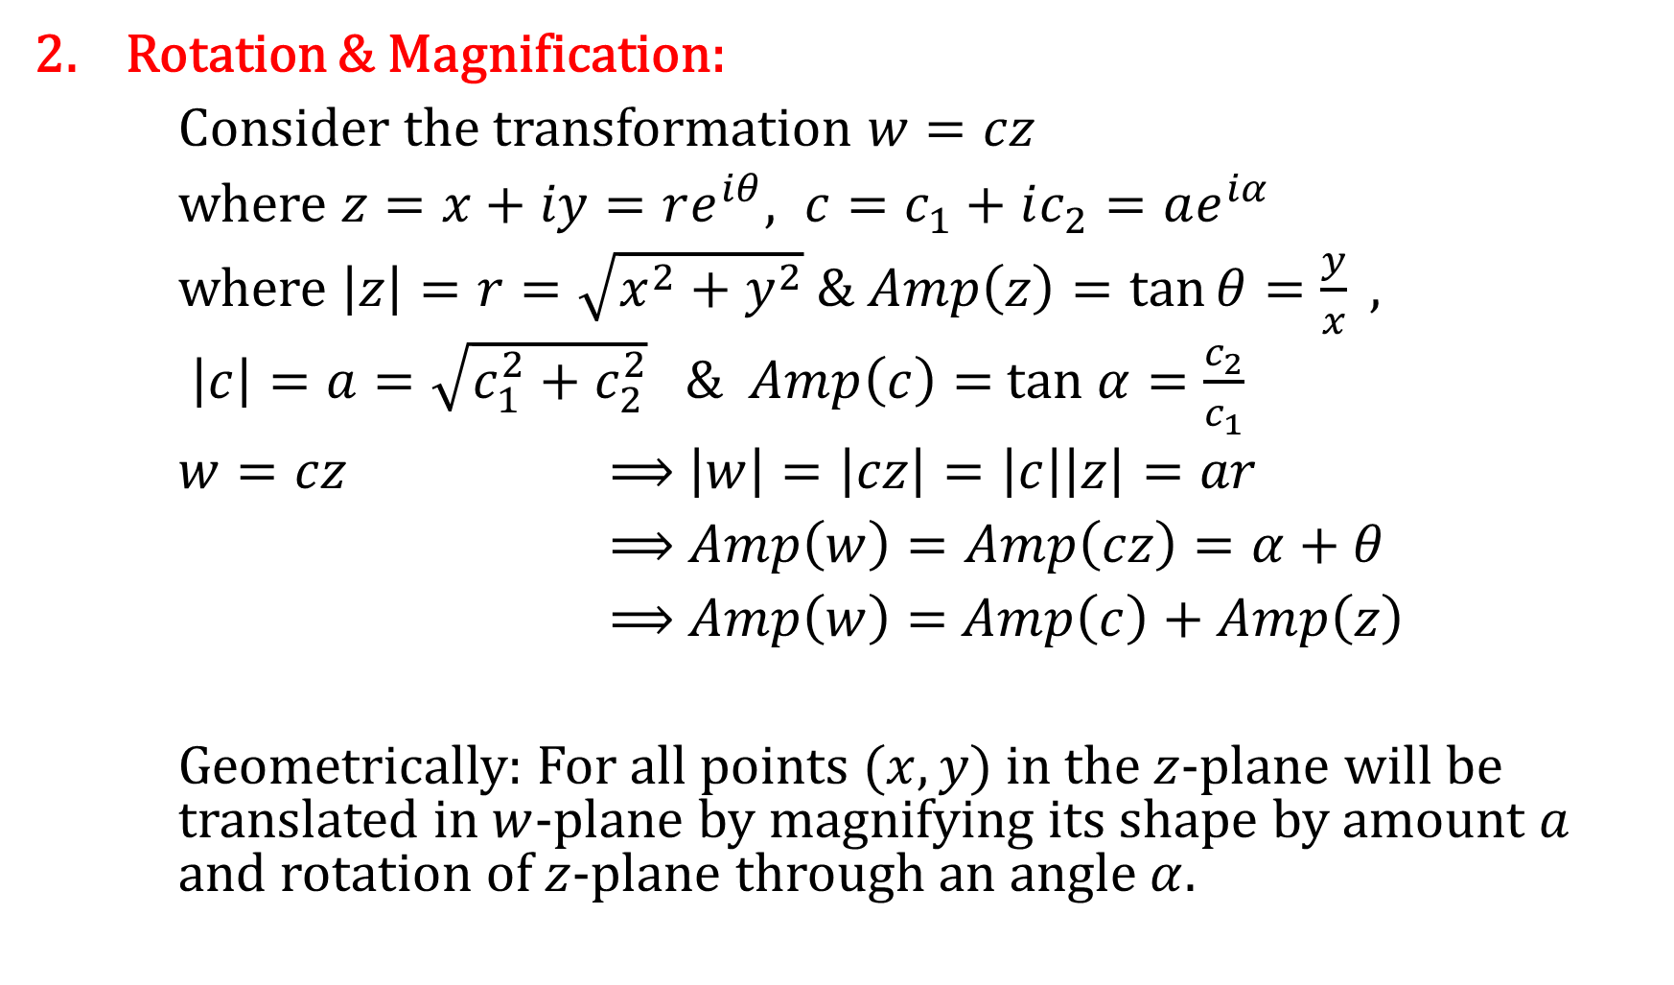
Some Important Transformations:
2. Rotation & Magnification:
Consider the transformation $w=cz$
where $z=x+iy=re^{iθ}, c=c_{1}+ic_{2}=ae^{iα}$
where $\left|z\right|=r=\sqrt{x^{2}+y^{2}} \& Amp\left(z\right)=\tan{θ=\frac{y}{x}} ,$
$\left|c\right|=a=\sqrt{c_{1}^{2}+c_{2}^{2}}$ & $Amp\left(c\right)=$ $tan α=\frac{c_{2}}{c_{1}}$
$w=cz$ $⟹$ $\left|w\right|=\left|cz\right|=\left|c\right|\left|z\right|=ar$
$⟹$ $Amp\left(w\right)=Amp\left(cz\right)=α+θ$
$⟹$ $Amp\left(w\right)=$ $Amp\left(c\right)+Amp\left(z\right)$
Geometrically: For all points $(x,y)$ in the $z$-plane will be translated in $w$-plane by magnifying its shape by amount $a$ and rotation of $z$-plane through an angle $α$.

Slide 7
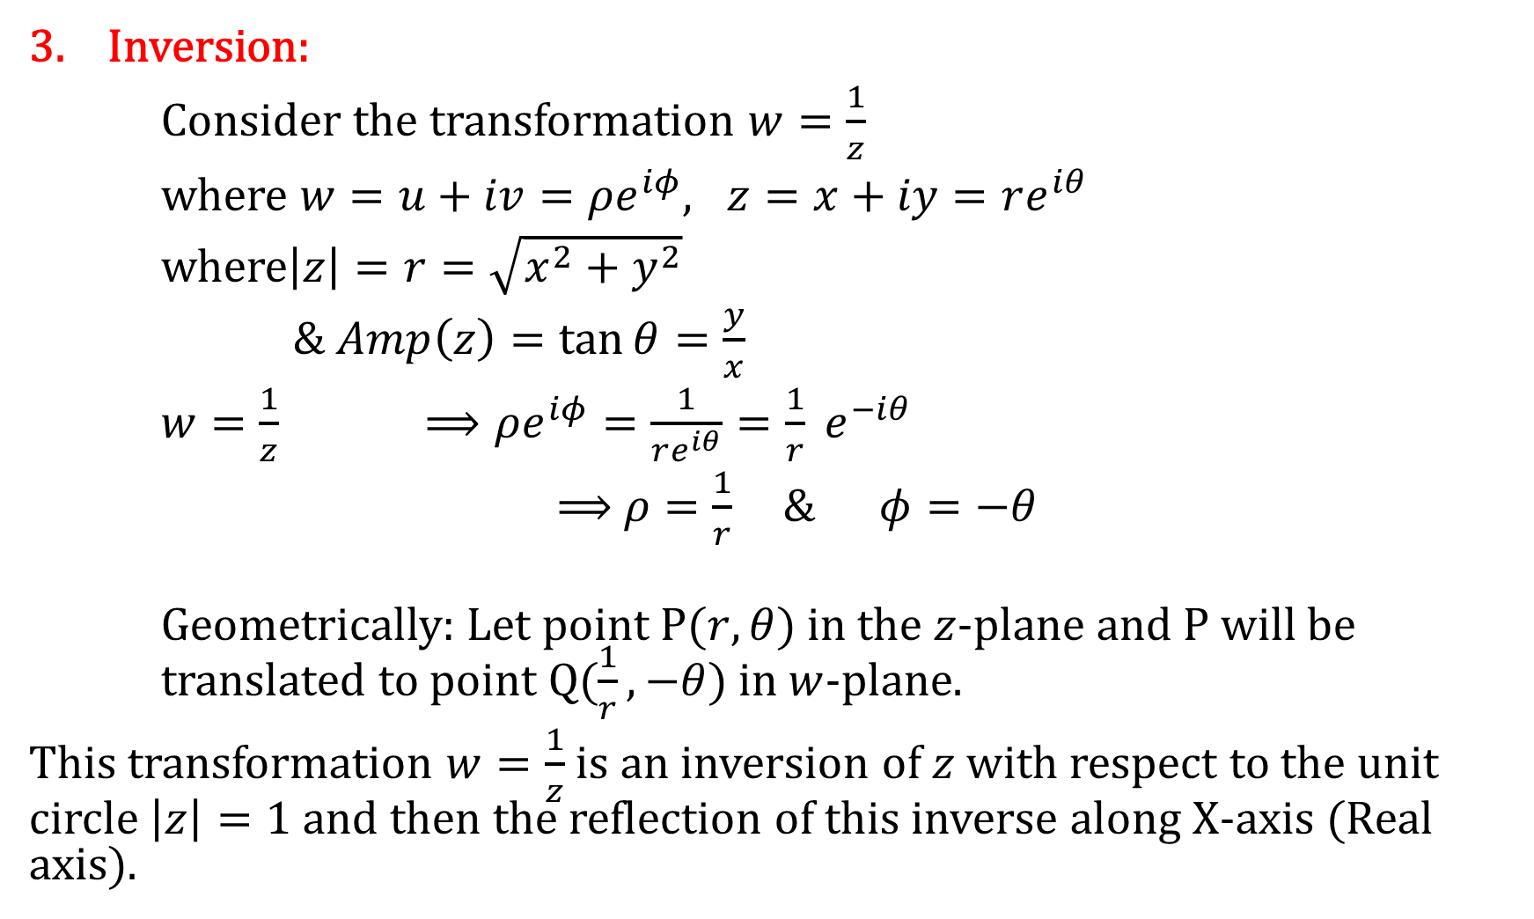
Some Important Transformations:
3. Inversion:
Consider the transformation $w=\frac{1}{z}$
where $w=u+iv=ρe^{iφ}, z=x+iy=re^{iθ}$
where$\left|z\right|=r=\sqrt{x^{2}+y^{2}}$
$\& Amp\left(z\right)=\tan{θ=\frac{y}{x}}$
$w=\frac{1}{z}$ $⟹ρe^{iφ}=\frac{1}{re^{iθ}}=\frac{1}{r} e^{−iθ}$
$⟹$ $ρ=\frac{1}{r} \& φ=−θ$
Geometrically: Let point P$(r,θ)$ in the $z$-plane and P will be translated to point Q$(\frac{1}{r},−θ)$ in $w$-plane.
This transformation $w=\frac{1}{z}$ is an inversion of $z$ with respect to the unit circle $\left|z\right|=1$ and then the reflection of this inverse along X-axis (Real axis).

Slide 8
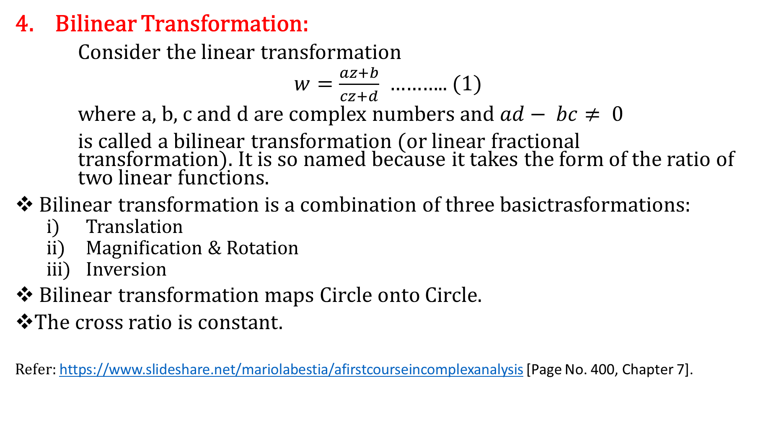
Some Important Transformations:
4. Bilinear Transformation:
Consider the linear transformation
$w=\frac{az+b}{cz+d}$ ……….. (1)
where a, b, c and d are complex numbers and $ad− bc≠ 0$
is called a bilinear transformation (or linear fractional transformation). It is so named because it takes the form of the ratio of two linear functions.
Bilinear transformation is a combination of three basictrasformations:
Translation
Magnification & Rotation
Inversion
Bilinear transformation maps Circle onto Circle.
The cross ratio is constant.
Refer: https://www.slideshare.net/mariolabestia/afirstcourseincomplexanalysis [Page No. 400, Chapter 7].

Slide 9
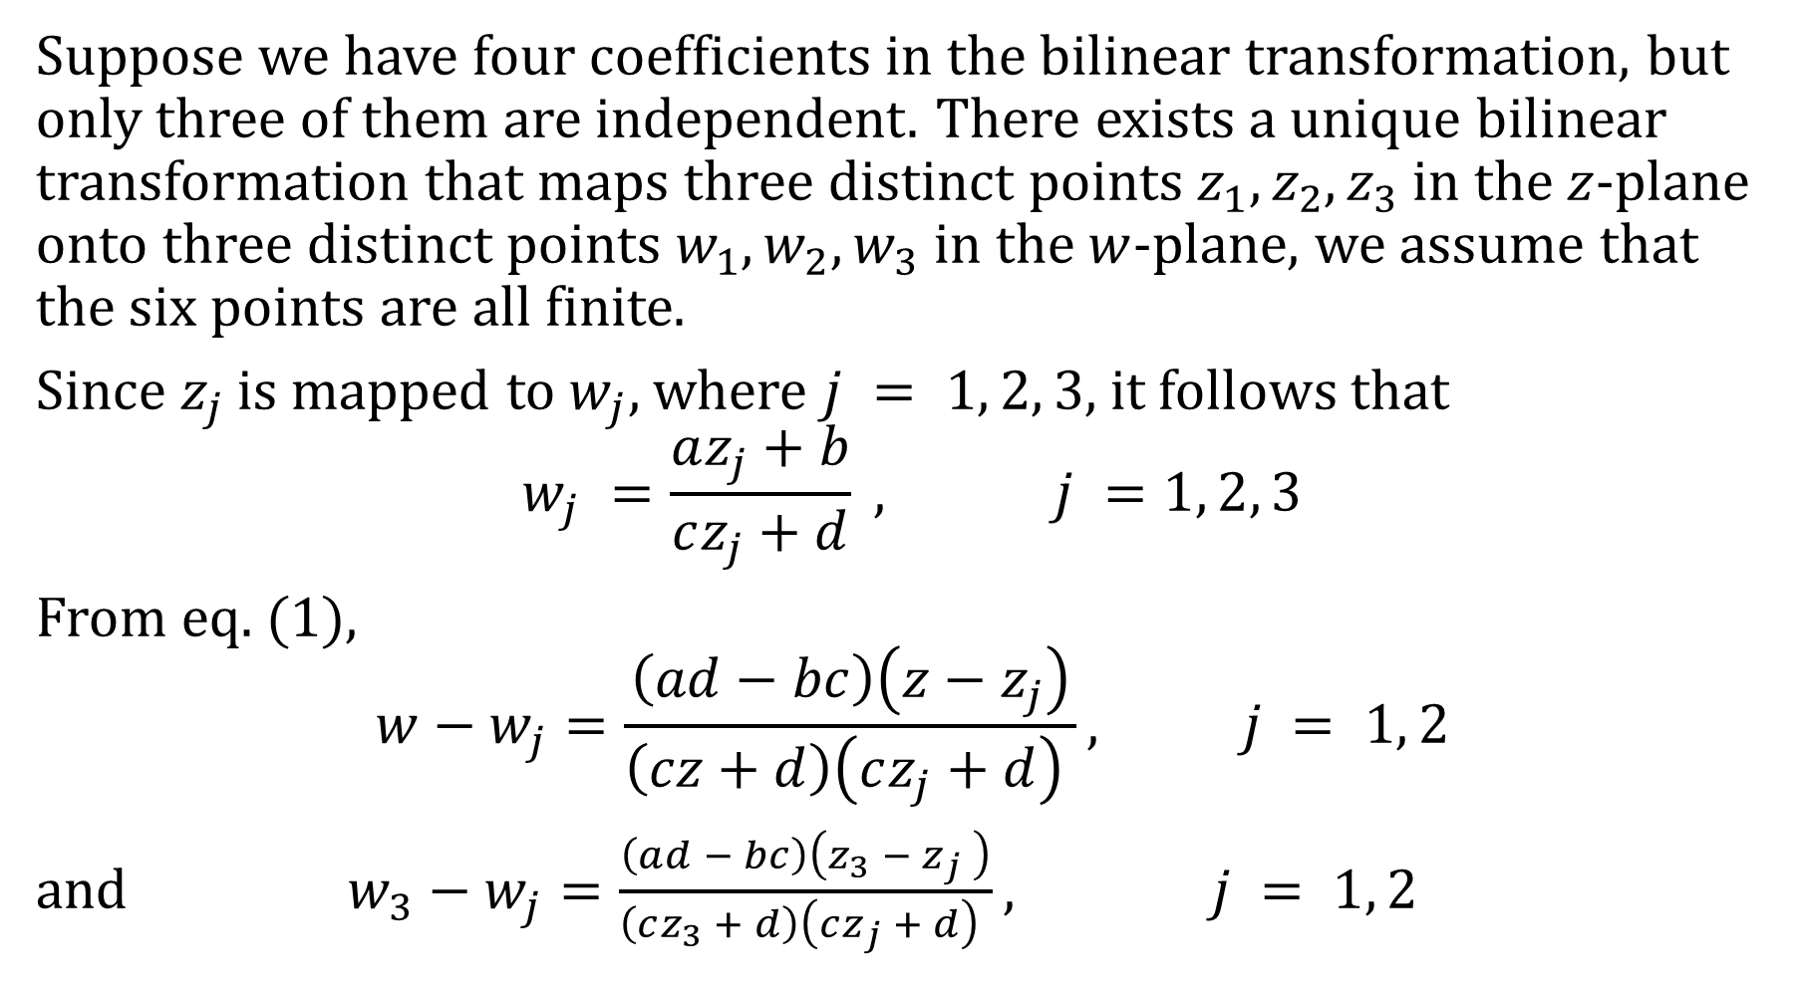
Bilinear Transformation:
Suppose we have four coefficients in the bilinear transformation, but only three of them are independent. There exists a unique bilinear transformation that maps three distinct points $z_{1}, z_{2}, z_{3}$in the $z$-plane onto three distinct points $w_{1},w_{2},w_{3}$ in the $w$-plane, we assume that the six points are all finite.
Since $z_{j}$ is mapped to $w_{j}$, where $j = 1, 2, 3$, it follows that
$$w_{j} =\frac{az_{j}+b}{cz_{j}+d} , j =1, 2, 3$$
From eq. (1),
$$w−w_{j}=\frac{\left(ad−bc\right)\left(z−z_{j}\right)}{\left(cz+d\right)\left(cz_{j}+d\right) }, j = 1, 2$$
and $w_{3}−w_{j}=\frac{\left(ad − bc\right)\left(z_{3} − z_{j} \right)}{\left(cz_{3} + d\right)\left(cz_{j} + d\right) }, j = 1, 2$

Slide 10
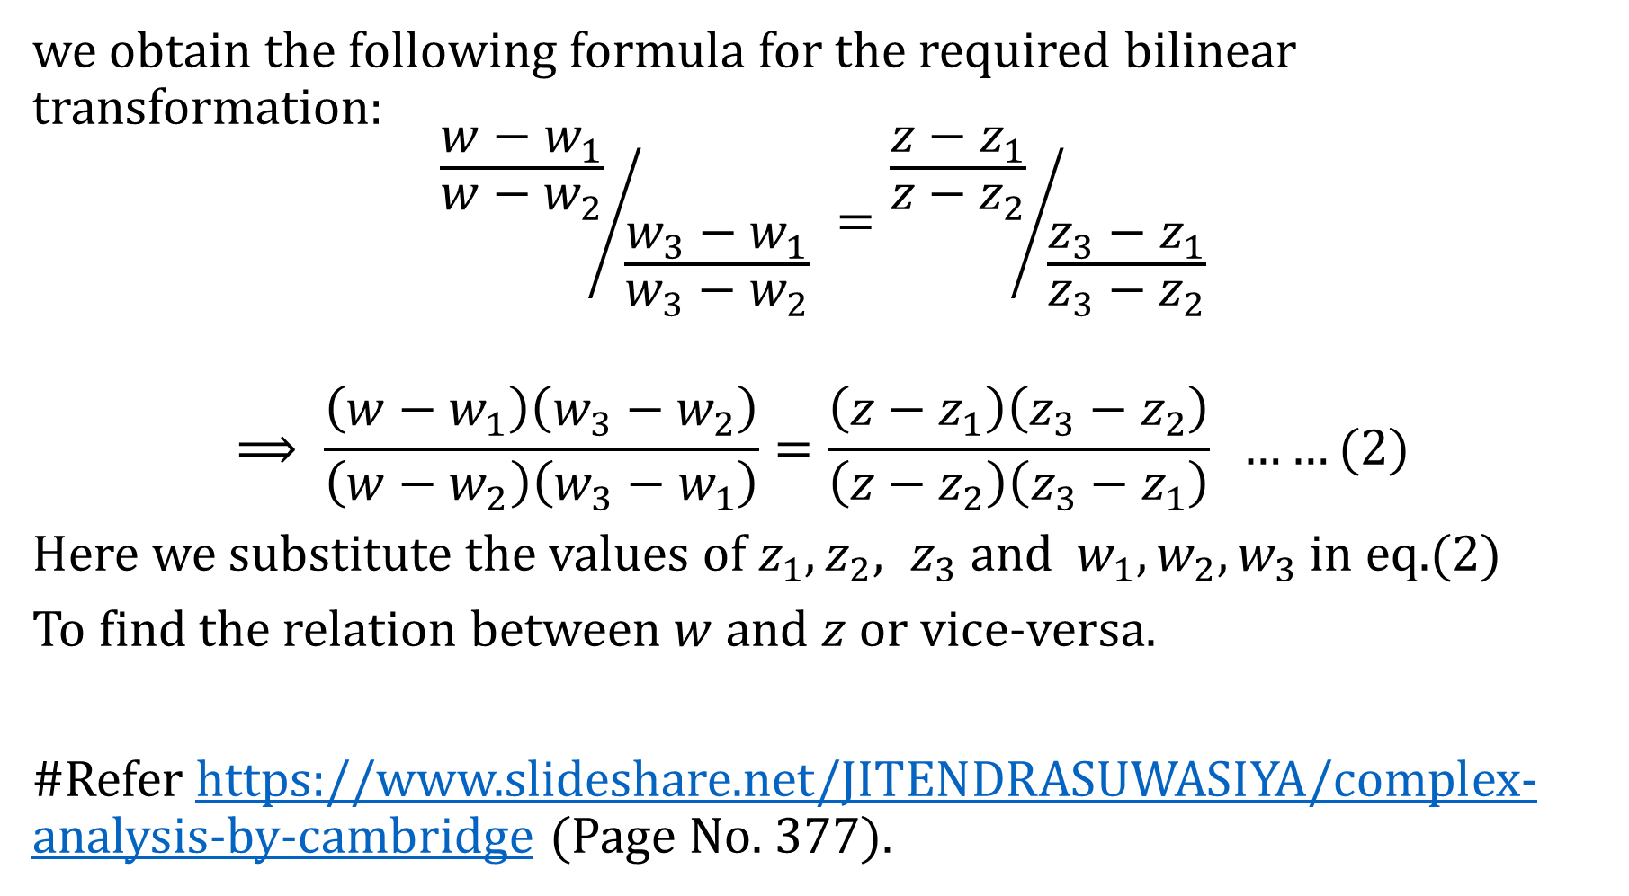
Bilinear Transformation:
we obtain the following formula for the required bilinear transformation:
$${\frac{w−w_{1}}{w−w_{2}}}/{\frac{w_{3}−w_{1}}{w_{3}−w_{2}}} ={\frac{z−z_{1}}{z−z_{2}}}/{\frac{z_{3}−z_{1}}{z_{3}−z_{2}}}$$
$$⟹ \frac{\left(w−w_{1}\right)\left(w_{3}−w_{2}\right)}{\left(w−w_{2}\right)\left(w_{3}−w_{1}\right)}=\frac{\left(z−z_{1}\right)\left(z_{3}−z_{2}\right)}{\left(z−z_{2}\right)\left(z_{3}−z_{1}\right)} ……(2)$$
Here we substitute the values of $z_{1}, z_{2}, z_{3}$ and $w_{1}, w_{2}, w_{3}$in eq.(2)
To find the relation between $w$ and $z$ or vice-versa.
#Refer https://www.slideshare.net/JITENDRASUWASIYA/complex-analysis-by-cambridge (Page No. 377).

Slide 11
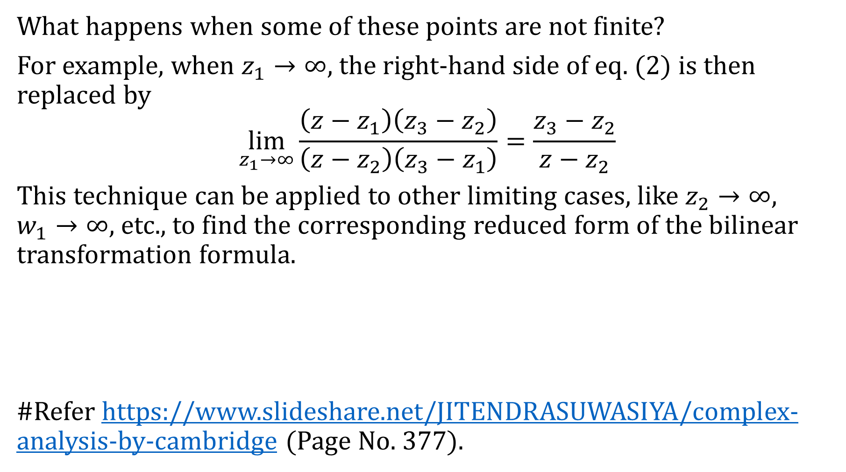
Bilinear Transformation:
What happens when some of these points are not finite?
For example, when $z_{1}→∞$, the right-hand side of eq. (2) is then replaced by
$$\lim_{z_{1}→∞}{\frac{\left(z−z_{1}\right)\left(z_{3}−z_{2}\right)}{\left(z−z_{2}\right)\left(z_{3}−z_{1}\right)}=\frac{z_{3}−z_{2}}{z−z_{2}}}$$
This technique can be applied to other limiting cases, like $z_{2}→∞$, $w_{1}→∞$, etc., to find the corresponding reduced form of the bilinear transformation formula.
#Refer https://www.slideshare.net/JITENDRASUWASIYA/complex-analysis-by-cambridge (Page No. 377).

Slide 12
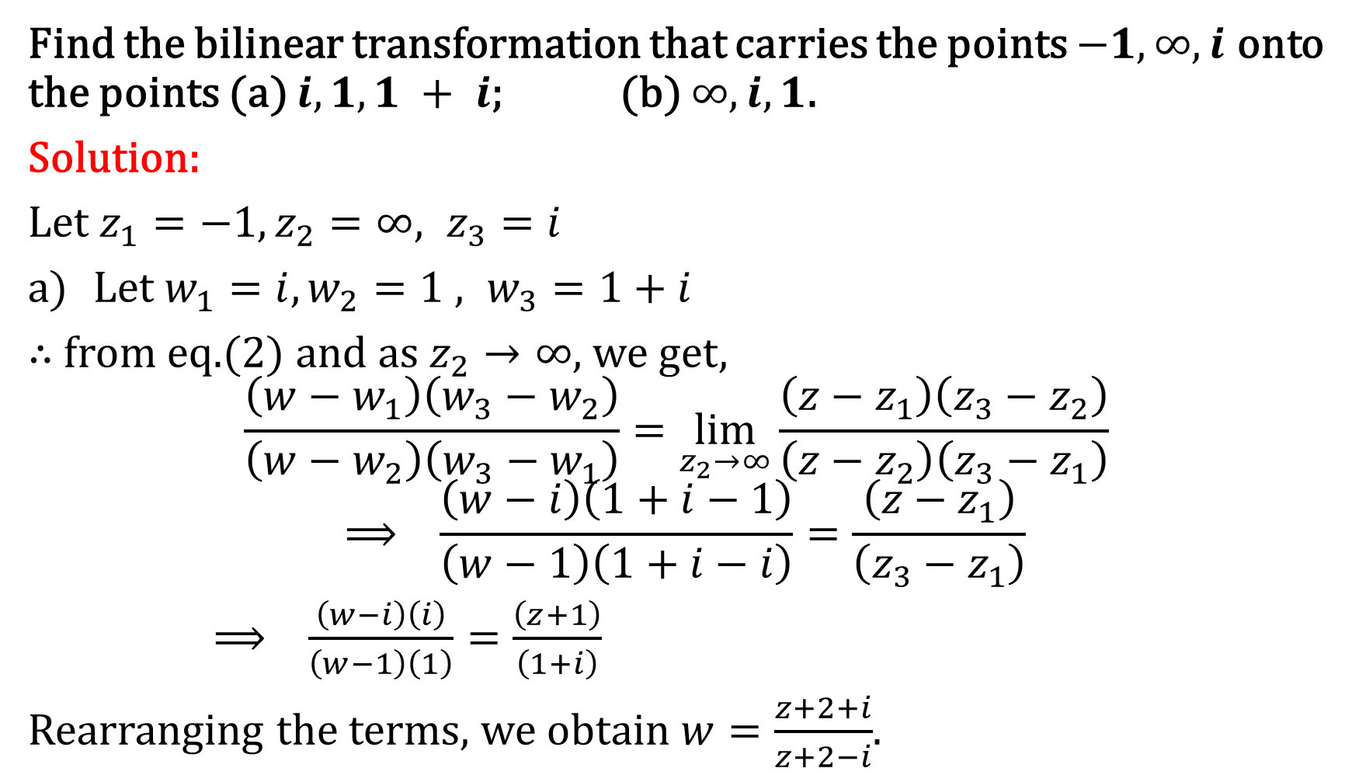
Example:
Find the bilinear transformation that carries the points $−1,∞, i$ onto the points (a) $i, 1, 1 + i$; (b) $∞, i, 1$.
Solution:
Let $z_{1}=−1, z_{2}=∞, z_{3}=i$
Let $w_{1}=i, w_{2}=1 , w_{3}=1+i$
$∴$from eq.(2) and as $z_{2}→∞$, we get,
$$\frac{\left(w−w_{1}\right)\left(w_{3}−w_{2}\right)}{\left(w−w_{2}\right)\left(w_{3}−w_{1}\right)}=\lim_{z_{2}→∞}{\frac{\left(z−z_{1}\right)\left(z_{3}−z_{2}\right)}{\left(z−z_{2}\right)\left(z_{3}−z_{1}\right)} }$$
$$⟹ \frac{\left(w−i\right)\left(1+i−1\right)}{\left(w−1\right)\left(1+i−i\right)}=\frac{\left(z−z_{1}\right)}{\left(z_{3}−z_{1}\right)}$$
$⟹ \frac{\left(w−i\right)\left(i\right)}{\left(w−1\right)\left(1\right)}=\frac{\left(z+1\right)}{\left(1+i\right)}{ }$
Rearranging the terms, we obtain $w=\frac{z+2+i}{z+2−i}$.

Slide 13
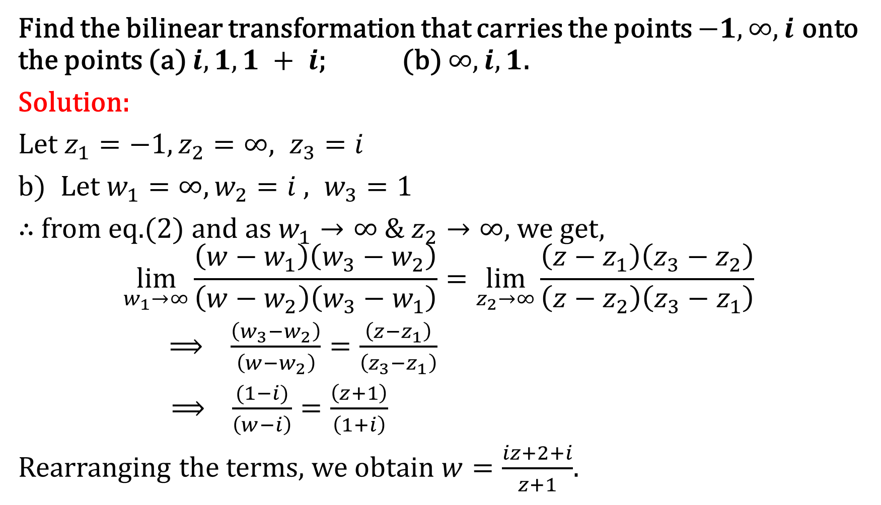
Example:
Find the bilinear transformation that carries the points $−1,∞, i$ onto the points (a) $i, 1, 1 + i$; (b) $∞, i, 1$.
Solution:
Let $z_{1}=−1, z_{2}=∞, z_{3}=i$
Let $w_{1}=∞, w_{2}=i , w_{3}=1$
$∴$from eq.(2) and as ${w_{1}→∞ \& z}_{2}→∞$, we get,
$$\lim_{w_{1}→∞}{\frac{\left(w−w_{1}\right)\left(w_{3}−w_{2}\right)}{\left(w−w_{2}\right)\left(w_{3}−w_{1}\right)}}=\lim_{z_{2}→∞}{\frac{\left(z−z_{1}\right)\left(z_{3}−z_{2}\right)}{\left(z−z_{2}\right)\left(z_{3}−z_{1}\right)} }$$
$⟹ \frac{\left(w_{3}−w_{2}\right)}{\left(w−w_{2}\right)}=\frac{\left(z−z_{1}\right)}{\left(z_{3}−z_{1}\right)}$
$⟹ \frac{(1−i)}{\left(w−i\right)}=\frac{\left(z+1\right)}{\left(1+i\right)}{ }$
Rearranging the terms, we obtain $w=\frac{iz+2+i}{z+1}$.

Slide 14
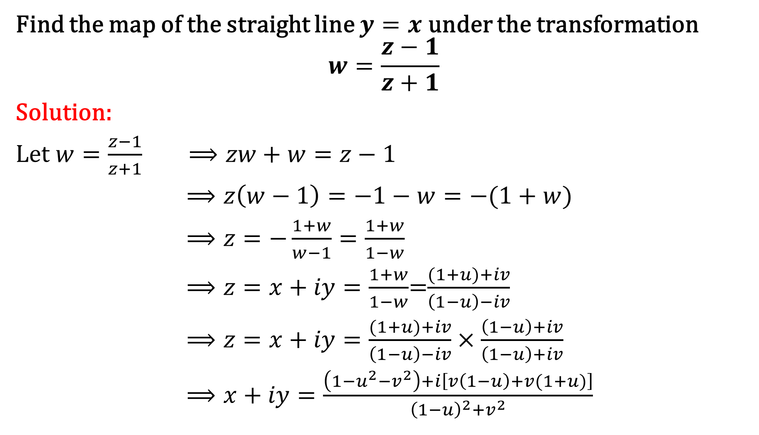
Example:
Find the map of the straight line $y=x$ under the transformation
$$w=\frac{z−1}{z+1}$$
Solution:
Let $w=\frac{z−1}{z+1} ⟹zw+w=z−1$
$⟹z\left(w−1\right)=−1−w=−(1+w)$
$⟹z=−\frac{1+w}{w−1}=\frac{1+w}{1−w}$
$⟹z=x+iy=\frac{1+w}{1−w}$=$\frac{(1+u)+iv}{\left(1−u\right)−iv}$
$⟹z=x+iy=\frac{(1+u)+iv}{\left(1−u\right)−iv}$ $×\frac{\left(1−u\right)+iv}{\left(1−u\right)+iv}$
$⟹x+iy=\frac{\left(1−u^{2}−v^{2}\right)+i\left[v\left(1−u\right)+v(1+u)\right]}{{\left(1−u\right)}^{2}+v^{2}}$

Slide 15
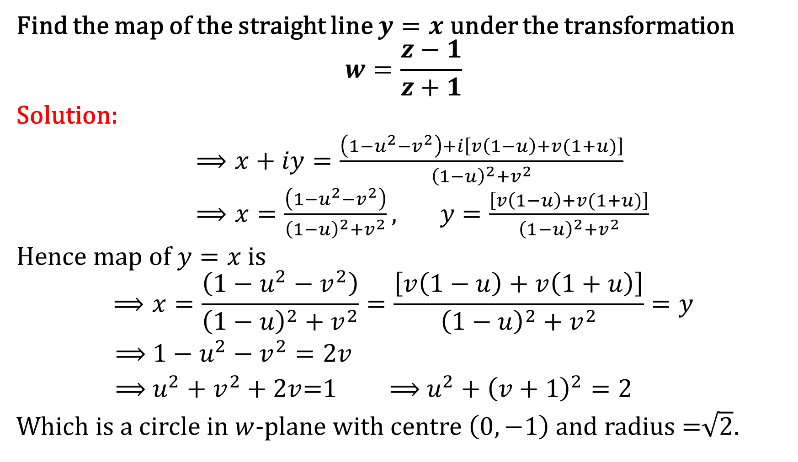
Example:
Find the map of the straight line $y=x$ under the transformation
$$w=\frac{z−1}{z+1}$$
Solution:
$⟹x+iy=\frac{\left(1−u^{2}−v^{2}\right)+i\left[v\left(1−u\right)+v(1+u)\right]}{{\left(1−u\right)}^{2}+v^{2}}$
$⟹x=\frac{\left(1−u^{2}−v^{2}\right)}{{\left(1−u\right)}^{2}+v^{2}}, y=\frac{\left[v\left(1−u\right)+v(1+u)\right]}{{\left(1−u\right)}^{2}+v^{2}}$
Hence map of $y=x$ is
$$⟹x=\frac{\left(1−u^{2}−v^{2}\right)}{{\left(1−u\right)}^{2}+v^{2}}=\frac{\left[v\left(1−u\right)+v\left(1+u\right)\right]}{{\left(1−u\right)}^{2}+v^{2}}=y$$
$⟹$ $1−u^{2}−v^{2}=2v$
$⟹$ $u^{2}+v^{2}+2v$=1 $⟹$ $u^{2}+{\left(v+1\right)}^{2}=2$
Which is a circle in $w$-plane with centre $\left(0,−1\right)$ and radius =$\sqrt{2}$.

Slide 16
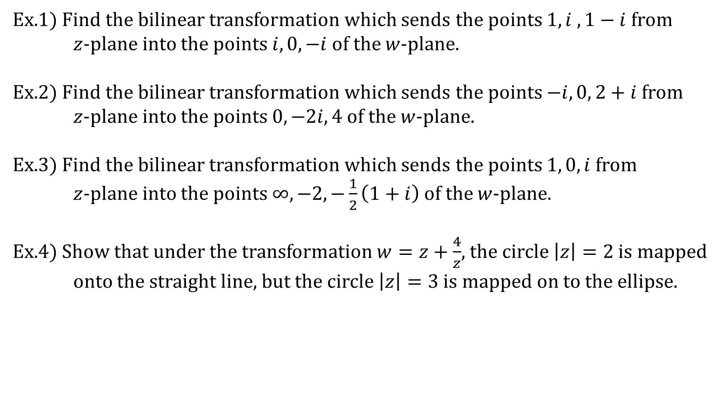
Exercise:
Ex.1) Find the bilinear transformation which sends the points $1, i , 1−i$ from $z$-plane into the points $i, 0, −i$ of the $w$-plane.
Ex.2) Find the bilinear transformation which sends the points $−i, 0, 2+i$ from $z$-plane into the points $0, −2i, 4$of the $w$-plane.
Ex.3) Find the bilinear transformation which sends the points $1, 0, i$ from $z$-plane into the points $∞, −2, −\frac{1}{2}\left(1+i\right)$ of the $w$-plane.
Ex.4) Show that under the transformation $w=z+\frac{4}{z}$, the circle $\left|z\right|=2$ is mapped onto the straight line, but the circle $\left|z\right|=3$is mapped on to the ellipse.

